Slide 1
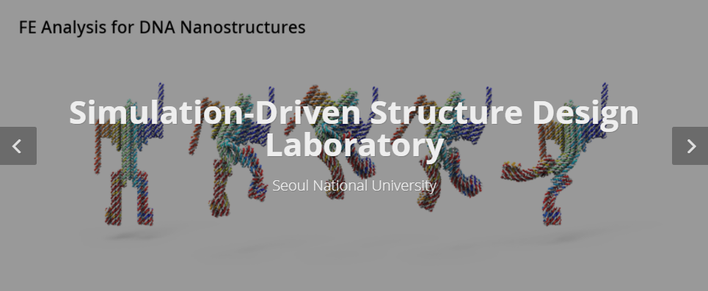
PINN Papers Summary
Jiwon Kang
MS-PhD Program of Mechanical Engineering
Seoul National University, South Korea

Slide 2
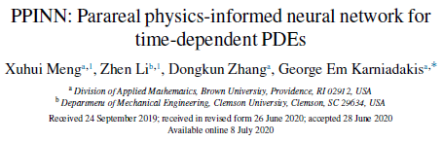


1. PPINN

Slide 3
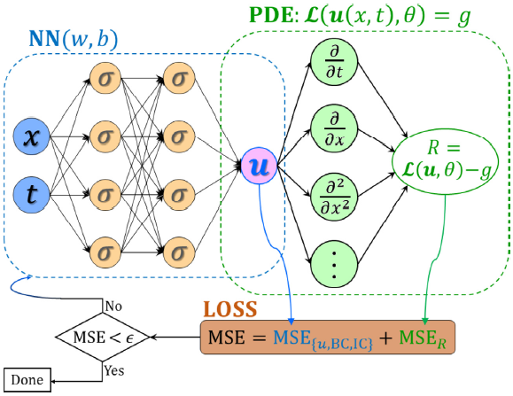
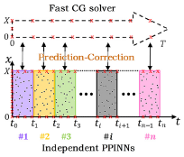
Main Idea
1. PPINN
many independent short time problem
long time problem
- parallelized computing on multiple cores -> faster
- Fast CG PINN + short time comparted PINNs

Slide 4
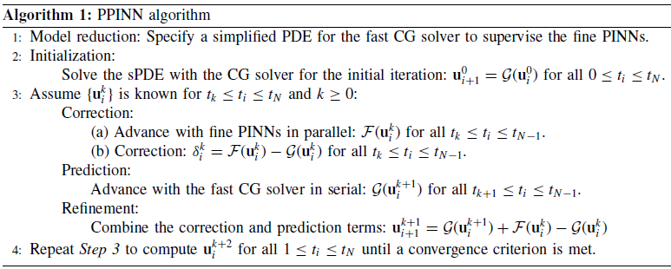
Methodology
1. PPINN
Simplify the PDE -> sPDE
CG PINN solve sPDE for the entire time domain
Decompose time domain into N subdomains
Use solutions from CG PINN as IC to run N fine PINNs in parallel
Obtain the discrepancy and use as a correction for next iteration
Continue iteration until satisfying the criterion -> transfer learning

Slide 5

Example Case: Deterministic ODE
1. PPINN
simplify
10 subdomains
compart
1st iteration (k=0)
- Train the CG PINN -> obtain whole prediction of the solution G(k=0)
- Use G(k=0) as IC -> Train 10 fine PINNs in parallel F(k=0)
- Calculate the deviation
2nd iteration (k=1)
- Train the CG PINN (same parameters from 1st iteration) -> update with deviation -> obtain G(k=1)
- G(k=1) + G,F(k=0) -> obtain F(k=1)
- Calculate deviation
3rd iteration and so on

Slide 6
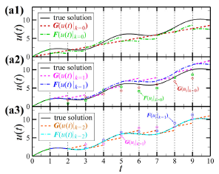
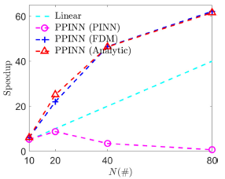
Example Case: Deterministic ODE
1. PPINN
<Convergence of PPINN>
<Speed up with various CG solvers>
simplified ODE
solved analytically
Use other numerical methods for CG solver
FDM, Analytic solution

Slide 7


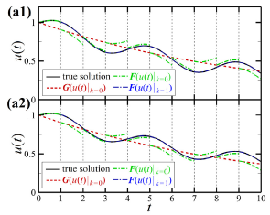
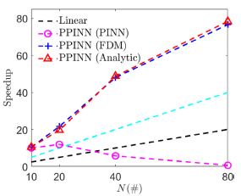
Example Case: Stochastic ODE
1. PPINN
simplify
<Convergence of PPINN>
<Speed up with various CG solvers>

Slide 8
Pros and Cons
1. PPINN
Pros
Reduce training cost
CG solver serve as IC for the fine PINNs -> PINNs run in parallel
Linear speed up with bigger numbers of sub-domains
2. CG solver can be any efficient numerical method
3. Break a big data set into multiple small data sets
can train a PINN on CPU resources
Cons
In-continuous solution along the boundaries of sub-domains

